Slide 1

Computer Programming for Engineers
Week 12 Lecture 1
Nov. 15, 2022
Lecturer: Dr. Mohammad Mahdi Javidan
College of Engineering, Sungkyunkwan University
Fall Semester 2022

Slide 2


Representation of Numbers
Decimal system or base 10, a number is represented by a list of digits from 0 to 9
Binary or base 2, is a very important representation of numbers for computers.
Digits in a binary number are also known as a bit
College of Engineering, Sungkyunkwan University

Slide 3

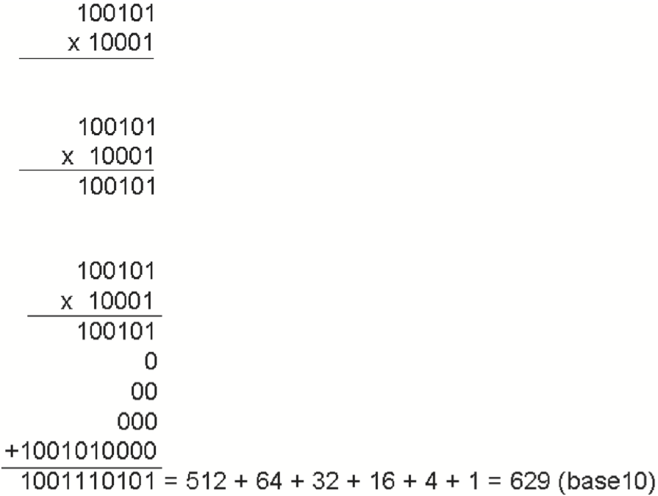
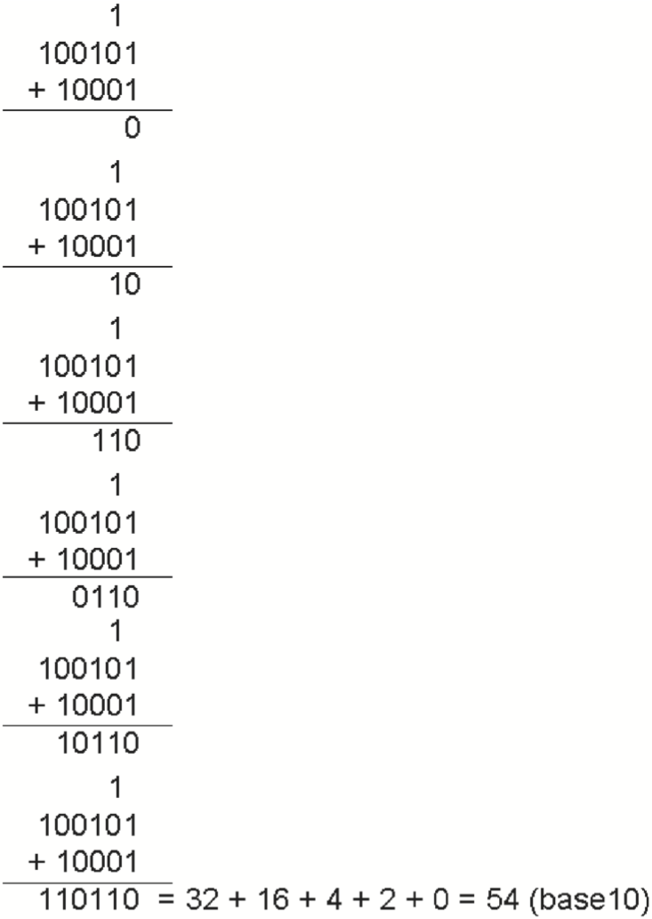
Base-N and Binary
College of Engineering, Sungkyunkwan University

Slide 4
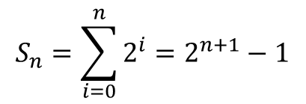
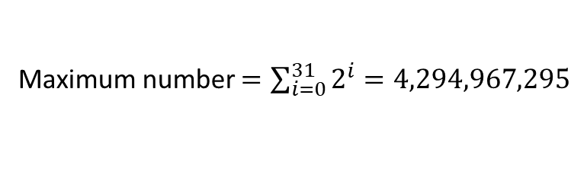
Base-N and Binary
a 32-bit computer can represent and process 32-digit binary numbers and no more.
$$S_{n}=\sum_{i=0}^{n}{2^{i}}=2^{n+1}−1$$
Maximum number $=\sum_{i=0}^{31}{2^{i}}=4,294,967,295$
Today, most computers have 64-bit processors. Even phones have largely moved to 64-bit; Apple’s iPhone 5s, released in 2013, was the first smartphone to have a 64-bit chip *.
* https://www.next7it.com/insights/64-bit-32-bit-mean/
College of Engineering, Sungkyunkwan University

Slide 5





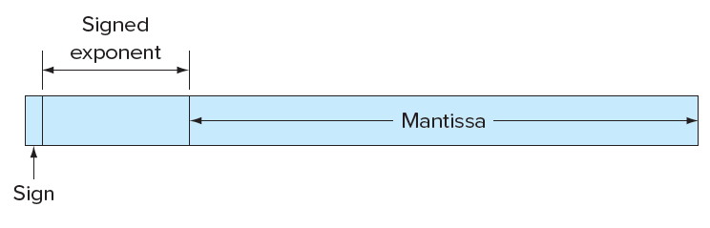
Floating Point Numbers
Mantissa, Significands, or Fraction
Exponent
Storing when 4 decimal points are allowed
Base
Normalized
Mantissa is limited to:
College of Engineering, Sungkyunkwan University

Slide 6
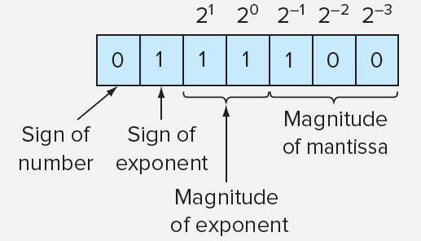
Floating-Point Representation
Let’s assume we have a hypothetical floating-point set
Let the first bit be the sign
Next 3 bits for the sign and magnitude of the exponent
Last 3 bits for the magnitude of mantissa
Smallest positive number: 0.0625 (base-10)
College of Engineering, Sungkyunkwan University

Slide 7
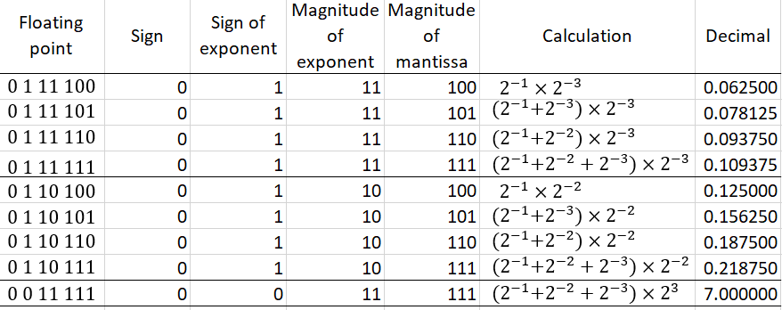
Floating-Point Representation
College of Engineering, Sungkyunkwan University

Slide 8
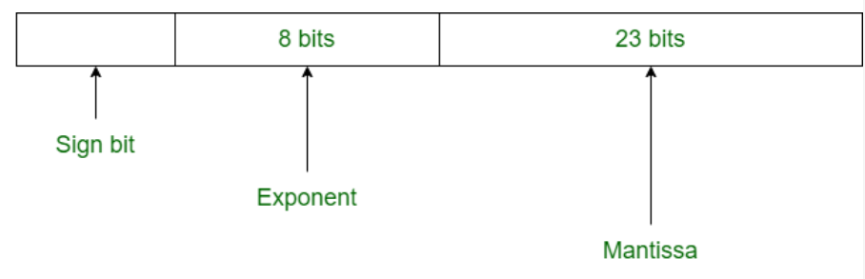
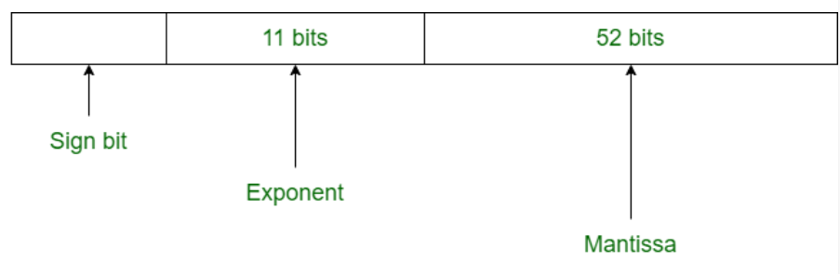

Floating-Point Representation
IEEE754 Standard
Single precision
Double precision
Bias
College of Engineering, Sungkyunkwan University

Slide 9
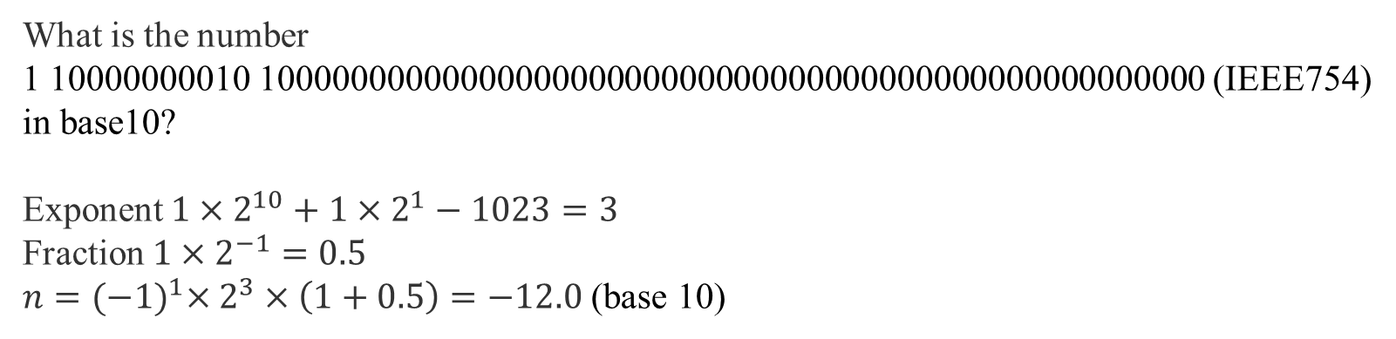
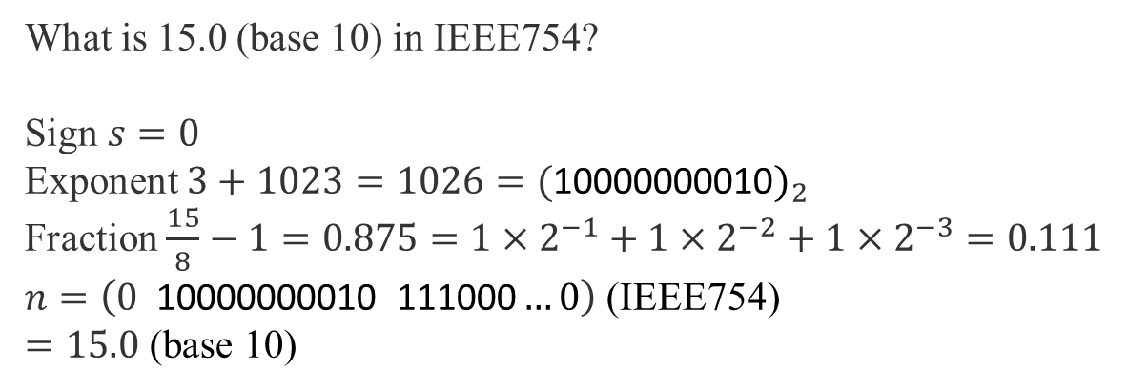
Floating-Point Representation
What is the number
1 10000000010 1000000000000000000000000000000000000000000000000000 (IEEE754)
in base10?
Exponent $1×2^{10}+1×2^{1}−1023=3$
Fraction $1×2^{−1}=0.5$ $n={(−1)}^{1}×2^{3}×\left(1+0.5\right)=−12.0$ (base 10)
What is 15.0 (base 10) in IEEE754?
Sign $s=0$
Exponent $3+1023=1026={(\text{10000000010})}_{2}$
Fraction $\frac{15}{8}−1=0.875=1×2^{−1}+1×2^{−2}+1×2^{−3}=0.111$ $n=\left(0 \text{10000000010}\text{ 111000}…0\right)$ (IEEE754)
$=15.0$ (base 10)
College of Engineering, Sungkyunkwan University

Slide 10
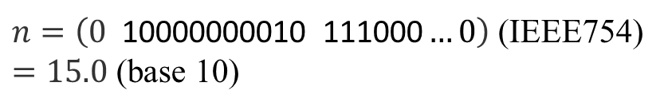
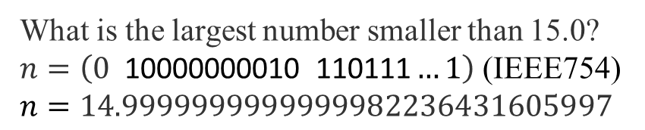
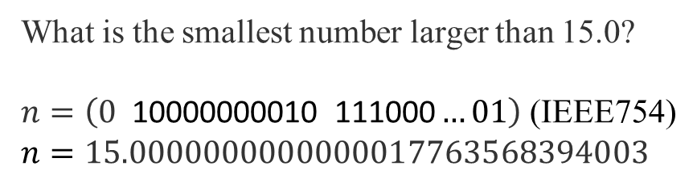
Floating-Point Representation
$n=\left(0 \text{10000000010}\text{ 111000}…0\right)$ (IEEE754)
$=15.0$ (base 10)
What is the smallest number larger than 15.0?
$n=\left(0 \text{10000000010}\text{ 111000}…01\right)$ (IEEE754)
$n=15.0000000000000017763568394003$
What is the largest number smaller than 15.0?
$n=\left(0 \text{10000000010}\text{ 110111}…1\right)$ (IEEE754)
$n=14.9999999999999982236431605997$
College of Engineering, Sungkyunkwan University

Slide 11
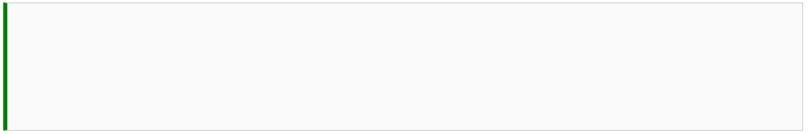




Floating-Point Representation
Gap between numbers
Any computation within this number and halfway between its immediate neighbors will be rounded 1e9
College of Engineering, Sungkyunkwan University

Slide 12



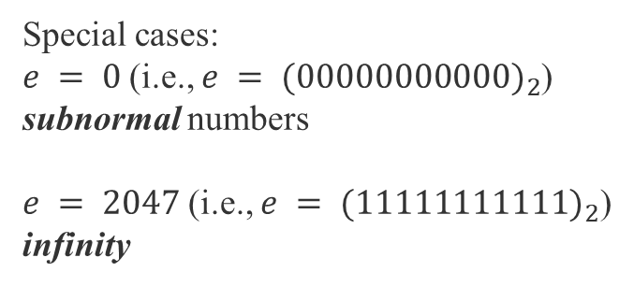
Floating-Point Representation
Special cases:
$e = 0$(i.e., $e = {(00000000000)}_{2}$)
subnormal numbers
$e = 2047$ (i.e., $e = {(11111111111)}_{2}$)
infinity
College of Engineering, Sungkyunkwan University

Slide 13





Floating-Point Representation
Numbers greater than the maximum number result in overflow (Python assigns inf)
Numbers less than the minimum number result in underflow (Python assigns 0)
$${(−1)}^{0}2^{1−1023}2^{−52}=2^{−1074}$$
College of Engineering, Sungkyunkwan University

Slide 14






Round-Off Error
round(number,digits)
digits is the number of decimals
College of Engineering, Sungkyunkwan University

Slide 15


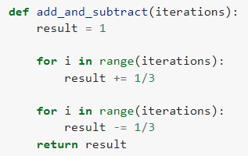




Round-Off Error
Accumulation of round-off error
College of Engineering, Sungkyunkwan University

